Slide 1
Student Admission prediction
Under the Guidence of
M. Venkata Rao, M.tech
Assistant Professor
Submitted by
J.Koteswararao (19471A05M0)
D.Harish(19471A05L0)
Sk.Mohammad Seeraj(19471A05O6)

Slide 2
contents
Abstarct
Introduction
Existing System
ML Models
Libraries and Models
Output screens
Conclusion
Feature Scope
Bibliography

Slide 3
Absract
In response to the highly competitive job market at present times, an increased interest in graduate studies has arisen. This has not only burdened applicants but also led to an increased workload on admission faculty members of universities. Any chance of abridging the admission process impelled applicants and faculty workers to look for faster, efficient, and more accurate methods for predicting admissions. The goal approach of this paper is to implement and compare several supervised predictive analysis methods on a labeled dataset based on real applications from the universities. Regression, classification, and Ensemble methods are all the supervised methods that are to be employed for prediction. The dataset relies profoundly on the academic performance of the applicants during their undergrad years. The coefficient of determination, as well as precision and accuracy, are the measures used to compare the different models. All predictive methods proved to show accurate results, however; certain methods proved to be more promising than others were. Predictions were obtained within short time frames, which in turn will cut down the time in the admission process by the chance of getting Admission

Slide 4
Introduction
Machine Learning is one of the applications of artificial intelligence (AI) that provides computers, the ability to learn automatically and improve from experience instead of explicitly programmed. It focuses on developing computer programs that can access data and use it to learn from themselves.The main aim is to allow computers to learn automatically without human intervention and also adjust actions accordingly.
This project mainly focuses on the how the get the admission chance of a student by taking the input values that can be predicted by using some related information. The scope of this project is the user can calculate the chance of getting admission based on some factors.

Slide 5
Existing System
Students want to know their Admission places where they can able to get the admission in the collage for their higher studies.
Student may predict their next admission chance by some mathematical calculations on previous marks. It takes lot of time and it is very difficult to predict manually.

Slide 6
Proposed System
We proposed to develop a system which will help students to predict their Admission chance in higher studies purpose based on some attributes which are nothing but their previous marks data as input values. So, this system can predict students Admission chance to get in the various universities within a short period of time and reduces manual difficulty. Proposed system uses Multiple Random Forest Regression Algorithm. This algorithm provides the output by processing different attributes.
Advantages:
1. Generates accurate and efficient results
2. Computation time is greatly reduced

Slide 7

Machine Learning
Machine learning is one of the applications of artificial intelligence (AI) that provides computers, the ability to learn automatically and improve from experience instead of explicitly programmed. It focuses on developing computer programs that can access data and use it to learn from themselves.The main aim is to allow computers to learn automatically without human intervention and also adjust actions accordingly.

Slide 8
Libraries
Numpy
Pandas
Matplotlib
seaborn
Scikit-learn
Random Forest Regressor
Flask

Slide 9
ML Models
Random Forest is a popular machine learning algorithm that belongs to the supervised learning technique. It can be used for both Classification and Regression problems in ML. It is based on the concept of ensemble learning, which is a process of combining multiple classifiers to solve a complex problem and to improve the performance of the model.
"Random Forest is a classifier that contains a number of decision trees on various subsets of the given dataset and takes the average to improve the predictive accuracy of that dataset."

Slide 10
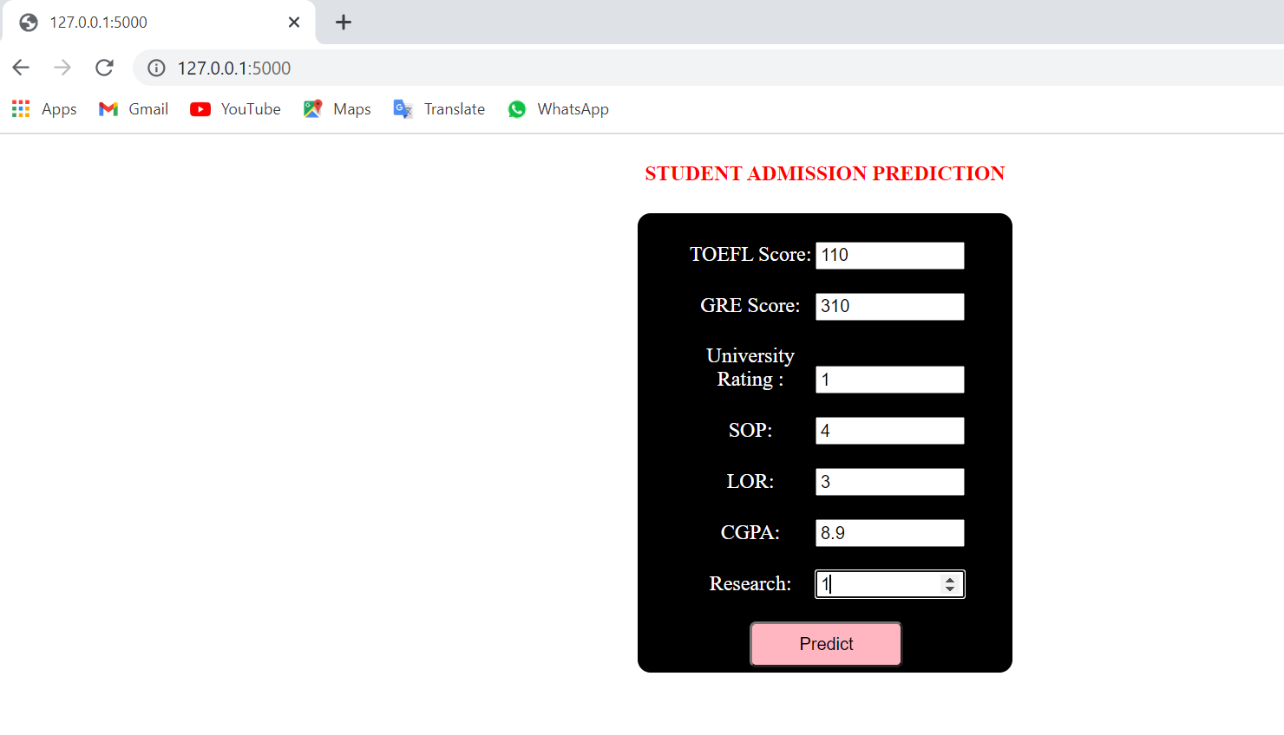
Predictions

Slide 11
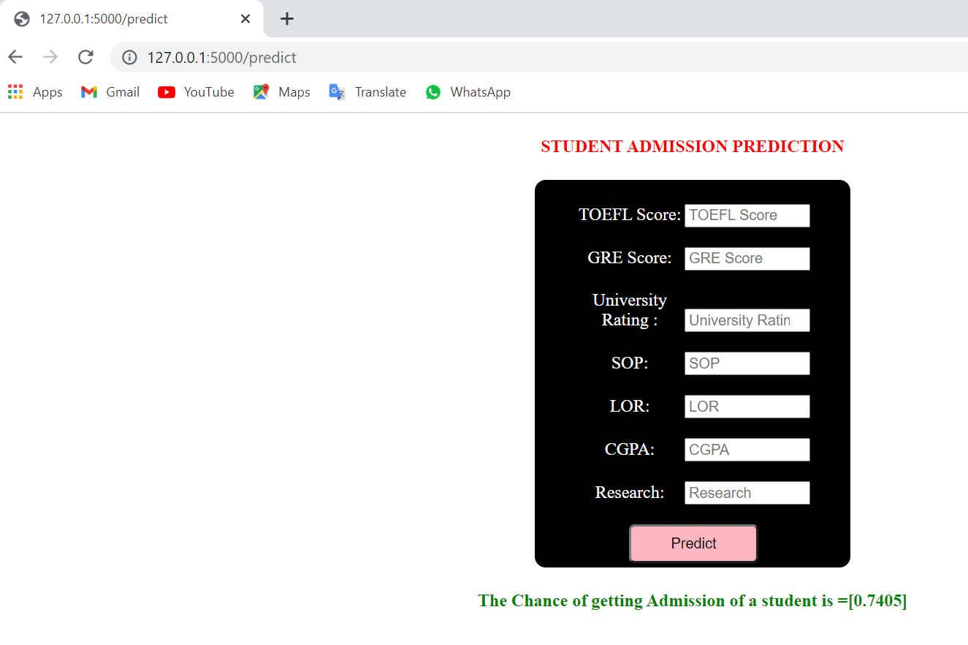

Slide 12
conclusion
Finally ,Student able to predict their admission chance for higher studies based on their performance in the respective exams like GRE,TOEFL and under graduated marks as input values.

Slide 13
Future enhancement
We will update our project by providing some more attributes to a student like attendance percentage, health status etc.,
By providing such attributes we can get more accuracy on predicting chance of getting student Admission for higher studies.
We will Enhance that which college that particular student get the Admission by providing accurate information about universities and their minimum requirements.

Slide 14
THANK YOU!

